Slide 1
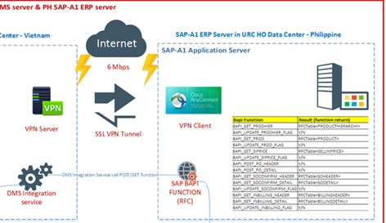
Integration SAP B1 – SAP PI – SAP ECC
Process Flow:
Inbound:
DMS B1 will push data by calling our PI Interface using RFC Adapter.
PI messages will be mapped to Idoc Segments and will be processed in SAP ECC.
Outbound:
Master and transaction data will generate Idoc messages.
Idoc messages will be mapped to XSD of DMS API.
Things to do:
ECC – Setup of IDOC, Custom IDOC development, Setup of Output types
PI Development for each interfaces
DMS – needs to develop API to receive data from PI
S2S VPN setup
Roles and accounts setup, transports, ECC connectivity configuration
PI Communication channels and IDOC Partner profile configuration
Vietnam
RFC Adapter IDoc
SAP PI
SAP Netweaver PI serves as the message broker. It is a wrapper that hides complexity of SAP ECC interfaces to DMS Integration Service. DMS push message as SAP BAPI, PI developer and ECC developer to decide how to post message to SAP ECC, Idoc or BAPI, whichever is suitable. This is also same approach for messages from SAP ECC going to DMS Integration service.
We only need to expose SAP PI with external parties. In SSL VPN tunnel, define firewall policy so that DMS Integration service is only allowed to connect to SAP PI not direct SAP ECC
Logging of message will be thru SAP PI. Generally SAP PI is only able to catch technical error (connection error, ABAP dump in SAP ECC). Application related error during posting should still be tracked in SAP ECC application logs for BAPI (SLG1) or Idoc Inbound Processing (BD87) for Idoc
Interfaces in SAP PI can easily be adopted to SAP ECC version. These are reusable interfaces for the next DMS roll-outs.

Slide 2
Interface List & Estimation
Interfaces | Method | Source | Target | Bapi Function | Development Effort | Functional Specification Effort | Functional Testing Effort | Infra Team Effort | Basis Team Effort
PRODUCT HIERARCHY | New create/ Update | SAP | PI | BAPI_GET_PRODHIER (Full Load)
 |  | PI | DMS | Config, Mapping
PRODUCT LIST | New create/ Update | SAP | PI | Setup of IDoc
 |  | PI | DMS | Config, Mapping
SELL-IN PRICE | New create/ Update | SAP | PI | Setup of IDoc
 |  | PI | DMS | Config, Mapping
PURCHASE ORDER | New create | DMS | PI | RFC to IDoc Mapping
 |  | PI | ECC | BAPI_POST_PO_SO_CREATE
SALES ORDER CONFIRM | New create/ Update | SAP | PI | Output Type, Idoc Setup
 |  | PI | DMS | Config, Mapping
INVOICE BILLING | New create | SAP | PI | Output Type, Idoc Setup
 |  | PI | DMS | Config, Mapping

